Slide 1
COS 212 B+-Trees

Slide 2
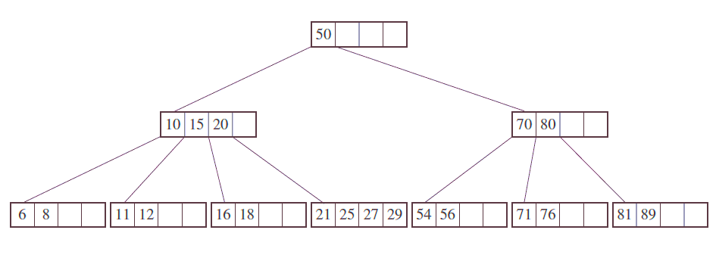
B-tree and B*-tree Traversals
What makes B-trees and B*-trees efficient?
If data is stored in secondary memory
Fetch the entire memory block, not just one data item
Very effective if we only need to find one item
What about an inorder traversal?
That is, printing all data sequentially
We had to fetch this node 4 times!

Slide 3
B+-trees
What if each leaf stores the address of the next leaf?
In other words, the leaf nodes are connected into a linked list
We can now print all the leaf data in order!
But this only partly solves the problem
What about the keys in the parents?
50
10
15
20
70
80
6
8
11
12
16
18
21
25
27
54
56
71
76
81
89

Slide 4
B+-trees
What if the parent keys are also stored in the leaves?
We can now print all the data in order
Is there another problem?
Redundancy!
A lot of memory can potentially be wasted, especially for big trees
We’ll get back to this when we discuss prefix B+-trees
50
10
15
20
70
80
6
8
10
11
12
15
16
18
20
21
25
27
50
54
56
70
71
76
80
81
89

Slide 5
B+-trees
Some more terminology
Index set vs sequence set
Why are we doing this?
We can still efficiently search for an individual item using the index set
We can efficiently retrieve data sequentially using the sequence set
Best of both worlds!
Index set
50
Sequence set
10
15
20
70
80
6
8
10
11
12
15
16
18
20
21
25
27
50
54
56
70
71
76
80
81
89

Slide 6
B+-trees: Insert
Find node where the key belongs by searching
If the key is placed into a leaf that still has room
Put the key in the correct place, shifting other keys as necessary
The index set remains unchanged!
Same as normal B-tree
10 | 15 | 20
6 | 8
10 | 11 | 12
15 | 16 | 18
20 | 21 | 25 | 27
Insert 7
10 | 15 | 20
6 | 7 | 8
10 | 11 | 12
15 | 16 | 18
20 | 21 | 25 | 27

Slide 7
B+-trees: Insert
If the key is placed into a full leaf
The leaf node where the key should be inserted is split in two, resulting in a new leaf node (new node in the sequence set)
The data of the full leaf is redistributed between the old leaf and the new leaf
The first key of the new leaf is copied to the parent
If the parent is full, split it according to the B-tree rules
Similar to normal B-tree, but middle value is copied to parent, not moved
10 | 15 | 20
Insert 30
6 | 7 | 8
10 | 11 | 12
15 | 16 | 18
20 | 21 | 25 | 27
25
20 21 25 27 30
10 | 15 | 20
6 | 7 | 8
10 | 11 | 12
15 | 16 | 18
20
21
25
27
30

Slide 8
B+-Trees: Insert Example
29
57
29
41
29
57
20
29
41
57
21
41
57
29
20
29
55
53
29
55
57
53
20 | 21
53
29 | 41
57

Slide 9
B+-Trees: Insert Example
28
29
53
37
26
56
24
20 | 21
41
53 | 55
29
57
24
12
24
29
53
22
23
21
21
24 | 26 | 28
29 | 37 | 41
53 | 55 | 56 | 57
20
21 | 24
60
29
53
21 | 22 | 23
24 | 26 | 28
29 | 37
53 | 55
12 | 20
56
57
56

Slide 10
B+-trees: Delete
Search for leaf containing key, and remove key
If leaf is still at least half full after deletion
Shift larger leaf keys to fill the gap
The index set remains unchanged!
Same as normal B-tree
10 | 15 | 20
Delete 25
6 | 7 | 8
10 | 11 | 12
15 | 16 | 18
20 | 21 | 25 | 27
10 | 15 | 20
6 | 7 | 8
10 | 11 | 12
15 | 16 | 18
20 | 21 | 27

Slide 11
B+-trees: Delete
What if the deleted key is still in the index set?
The index set key is still a valid search guide
No need to worry about updating it
10 | 15 | 20
Delete 20
6 | 7 | 8
10 | 11 | 12
15 | 16 | 18
20 | 21 | 27
10 | 15 | 20
6 | 7 | 8
10 | 11 | 12
15 | 16 | 18
21 | 27

Slide 12
B+-trees: Delete
If leaf is less than half full after deletion
If a sibling is more than half-full
Gather keys in leaf and sibling into a single list
Re-distribute keys between leaf and sibling
Copy leftmost key of the right leaf to the parent
Similar to normal B-tree, but only leaf node keys are redistributed, & parent key is overwritten
10 | 15 | 20
Delete 27
6 | 7 | 8
10 | 11 | 12
15 | 16 | 18
21 | 27
10 | 15 | 18
15 16 18 21
6 | 7 | 8
10 | 11 | 12
15 | 16
18 | 21

Slide 13
B+-trees: Delete
If leaf is less than half full after deletion
If neither sibling is more than half-full
Gather keys in leaf and sibling into a single list
Re-distribute all keys in leaf and sibling to the leftmost of the two
Delete parent key and rightmost leaf
Merge could propagate to the parent
Similar to normal B-tree, but only leaf node keys are redistributed
10 | 15 | 18
Delete 21
6 | 7 | 8
10 | 11 | 12
15 | 16
18 | 21
10 | 15
15 16 18
6 | 7 | 8
10 | 11 | 12
15 | 16 | 18

Slide 14
Prefix B+-trees
Suppose we use surnames as keys
Keys in non-terminal nodes are there just to guide the search
Is all the information in the non-terminal nodes necessary?
We can compress non-leaf keys to only contain relevant data
James
…
Bosman | Dlamini
Adams | Austin
Bosman | Carrim | Chili
Dlamini | Ganesh

Slide 15
Prefix B+-trees
The first letter of the surnames will be enough
We use prefixes as separators
Smallest part of the key sufficient to differentiate between two neighbouring keys
May be more than the first letter, depending on the data
Such B+-trees are referred to as simple prefix B+-trees
Less space is wasted
More keys will fit into a single node, leading to smaller trees!
J
…
B | D
Adams | Austin
Bosman | Carrim | Chili
Dlamini | Ganesh

Slide 16
Prefix B+-trees
Are B+-trees actually used in practice?
The ReiserFS, NSS, XFS, JFS, ReFS, and BFS filesystems
Use B+-trees for metadata indexing
BFS and NTFS
Use B+ trees for directory indexing
Relational database management systems like IBM DB2, Informix, Microsoft SQL Server, Oracle 8, Sybase ASE, and SQLite
Use B+ trees for table indices

